Slide 1

Hoodplaats
Neighbourhood bartering application

Slide 2

What does it do?
Hoodplaats is an application guided to bring neighbourhoods closer by making an easy-to-use hub for bartering and trading goods and tools

Slide 3
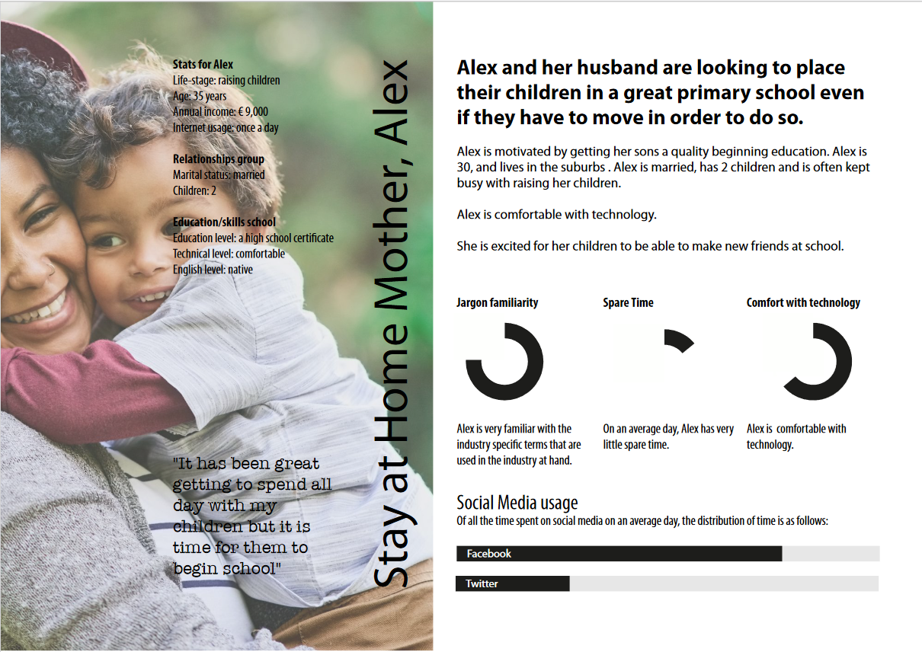

Slide 4
How does this satisfy our client’s needs?

Slide 5
The application’s core function satisfies the assigned domain of Shopping.
Our client stays at home for extended periods of time, purchasing goods either online or very close to her.
Studies show that more close-knit local communities are safer, hence interaction with neighbours will make the environment for the client and her children safer.

Slide 6

MVP Demo

Slide 7


Slide 8

Thank you for your attention!

